Slide 1
Immediate Mode GUI – Theory and Example
Adam Sawicki
http://asawicki.info

Slide 2
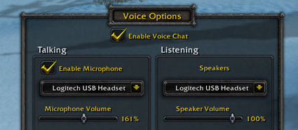
What is GUI?
Graphical User Interface (GUI)
aka Head-Up Display (HUD)
Displays information
Handles interaction
  Mouse, touch, keyboard, other controllers…

Slide 3
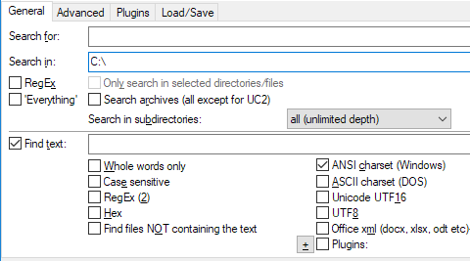
Implementation
Default system controls
  (Used in desktop apps)
  Pure system API: WinAPI
  C++ library: Qt, wxWidgets, …
  Another programming language: C#, Java, …


Slide 4
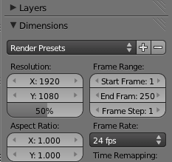
Implementation
Default system controls
Custom rendering
  (Used in games, graphics apps)
  Library: Scaleform, Dear ImGui, …
  Your own implementation

Slide 5
Architecture
Object-oriented – seems to be the most natural architecture for GUI
Class hierarchy for types of controls
Design patterns, e.g. composite
Fields: Position, Size, …
Methods: Show, Hide, Enable, Disable, …

Slide 6
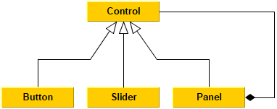
Architecture
Object-oriented – seems to be the most natural architecture for GUI

Slide 7
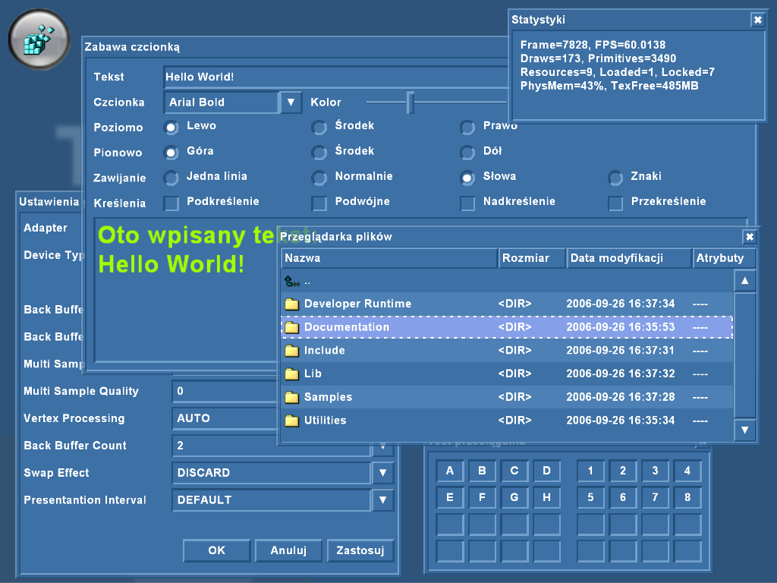
Example

Slide 8
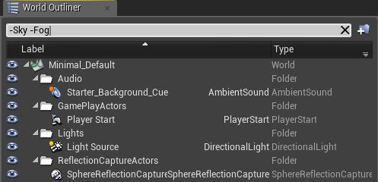
Some thoughts
Actual objects also form a hierarchy
  Every control is positioned relative to its parent
Similar to how games represent scene
  High-level approach found in game engines –
  hiearchy of objects

Slide 9
Immediate mode GUI – idea
On low level (DirectX, OpenGL, Vulkan), rendering is stateless – „immediate mode”
  Sequence of draw calls repeated every frame
What if… we could render GUI this way?
SetShader
SetTexture
DrawTriangles
SetTexture
DrawTriangles
…

Slide 10
Dear ImGui
https://github.com/ocornut/imgui
C++ library
  Bindings to many languages available
License: MIT
Author: Omar Cornut (game developer)
Suited for real-time rendering
  Efficient
  Graphics API agnostic

Slide 11
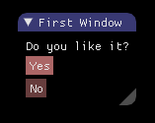
Example code
if(ImGui::Begin("First Window"))
{
ImGui::Text("Do you like it?");
ImGui::Button("Yes");
ImGui::Button("No");
ImGui::End();
}

Slide 12

Q: How are controls positioned?
Automatic – each control in new row
You can change this:
  PushItemWidth(item_width), SameLine()
  Columns: Columns(count)
  Grouping: BeginGroup(), EndGroup()
  Full control: GetCursorPos(), SetCursorPos(local_pos)

Slide 13
Q: How do I handle feedback?
You receive it the same moment you define a control
ImGui::Text("Do you really want to quit?");
if(ImGui::Button("Yes"))
ExitProgram();
if(ImGui::Button("No"))
CloseThisWindow();

Slide 14
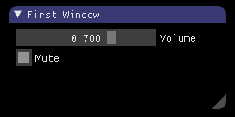
Q: Where is value of controls?
In your own variables
You pass pointers to them as you define controls
float volume = 0.7f;
bool mute = true;
ImGui::SliderFloat("Volume", &volume, 0.0f, 1.0f);
ImGui::Checkbox("Mute", &mute);

Slide 15
Q: How about other state?
There is other state
  Window position & size, focus, text selection, …
Kept inside ImGui library
  So it’s not truly stateless…
Controls are identified by hash from their labels
  If not unique, you can use "Label##UNIQUE_ID"
  You can also scope your labels: PushID(), PopID()

Slide 16
Q: How to render?
If your frame has Update() and Render():
  Do all ImGui inside Update()
  Inside Render() you must render it yourself
For rendering you receive a sequence of:
  Vertex array
  Index array
  Texture ID
  Scissor rectangle
Examples available for: DirectX 9, 10, 11, OpenGL, Vulkan, Allegro, …

Slide 17
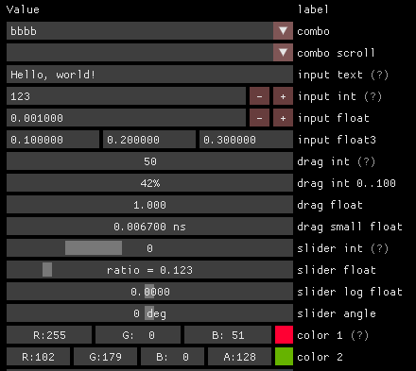
Features: Property grid
Suited to provide editing of properties of various types
  bool, int, float, string, enum
  vec2, vec3, vec4, color

Slide 18

Features: Fonts
Supports TTF fonts, loaded into atlas texture
You receive data for this texture,
need to upload it to GPU by yourself

Slide 19
Live demo

Slide 20
Conclusion
Dear ImGui is good for:
  Internal in-game GUI for debugging purposes
    Easy to use
    Efficient to render
Dear ImGui is not good for:
  Fully-featured game editor
    Not well suited for complicated GUI, better use system controls
  Final game HUD
    No possibility of skinning or making it look pretty
You can always make your own implementation
  Based on idea of Immediate Mode GUI!

Slide 21
Thank you
Questions?

